Slide 1






Exploring Groundwater Cases Across California
Group 8
Fawzia Almurbati
Khalid Alkooheji
Qassim Al Qatari

Slide 2


Introduction
Groundwater contamination continues to pose a threat to public health and environmental sustainability. With cases managed across different agencies and regions, we need to understand where the most critical issues are concentrated. Analyzing this data, we aim to highlight high-risk areas and recommend data-driven actions for environmental agencies.

Slide 3

What is Our Case?
As a data analytics team working on environmental monitoring, we've been assigned to analyze groundwater contamination data across California. To support effective decision-making and resource planning, we aim to identify contamination patterns, especially in military sites, regional oversight, and environmental vulnerability.

Slide 4
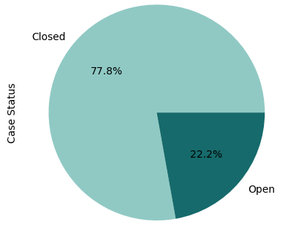

Groundwater Contamination Cases in CA
Figure 1: The majority of cases (77%) are marked as Closed, indicating completed or resolved investigations, while Open cases account for 22%, reflecting ongoing or unresolved environmental concerns.

Slide 5
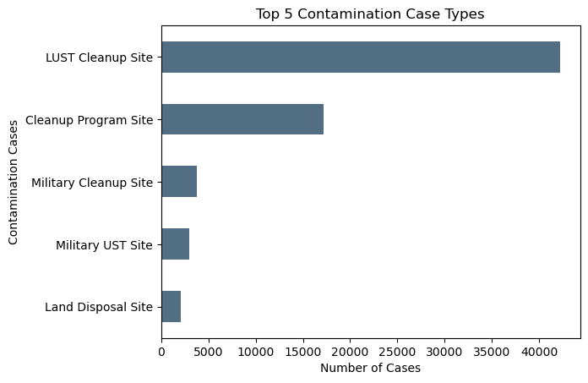
Top 5 Contamination
Case Types
Figure 2: LUST Cleanup Sites account for most cases, highlighting a key focus on underground storage tank contamination.

Slide 6
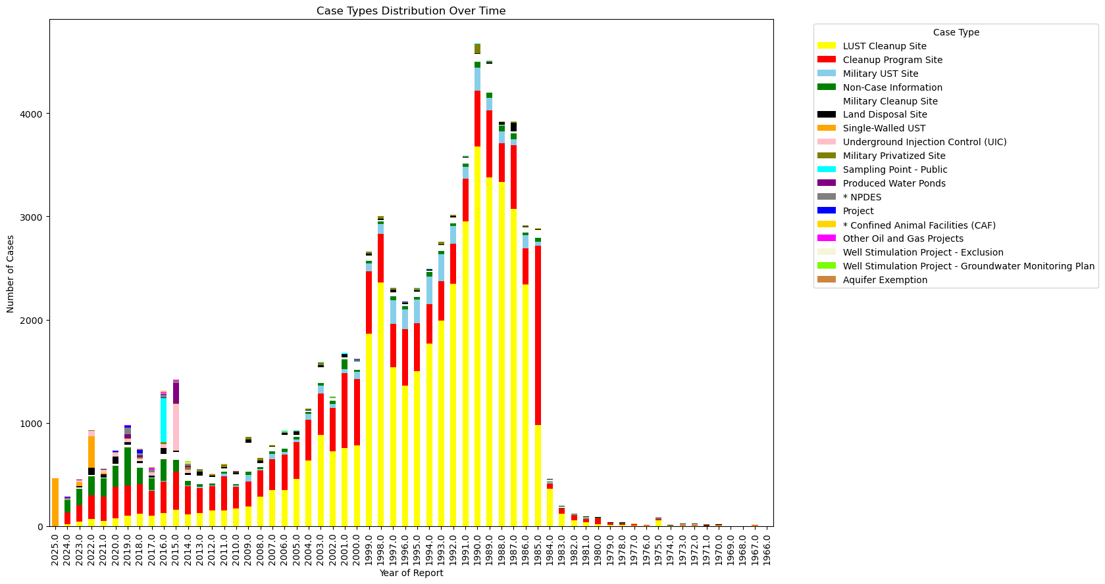
Case Types Distribution Over Time
Figure 3: The figure shows a rise in groundwater contamination cases peaking in the 1990s, dominated by LUST Cleanup Sites, followed by a gradual decline and diversification of case types in recent years.

Slide 7
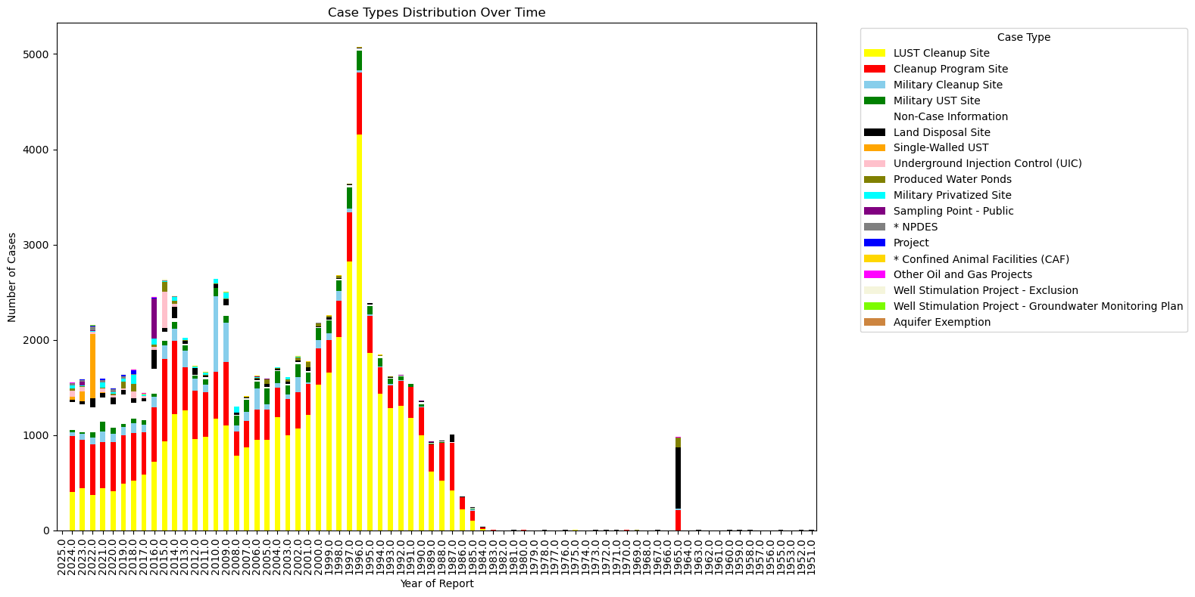
Case Types Distribution Over Time
Figure 4: This stacked bar chart displays the distribution of various case types reported annually from approximately 1970 to 2025, highlighting changes in case type prevalence and total reported cases over time.

Slide 8



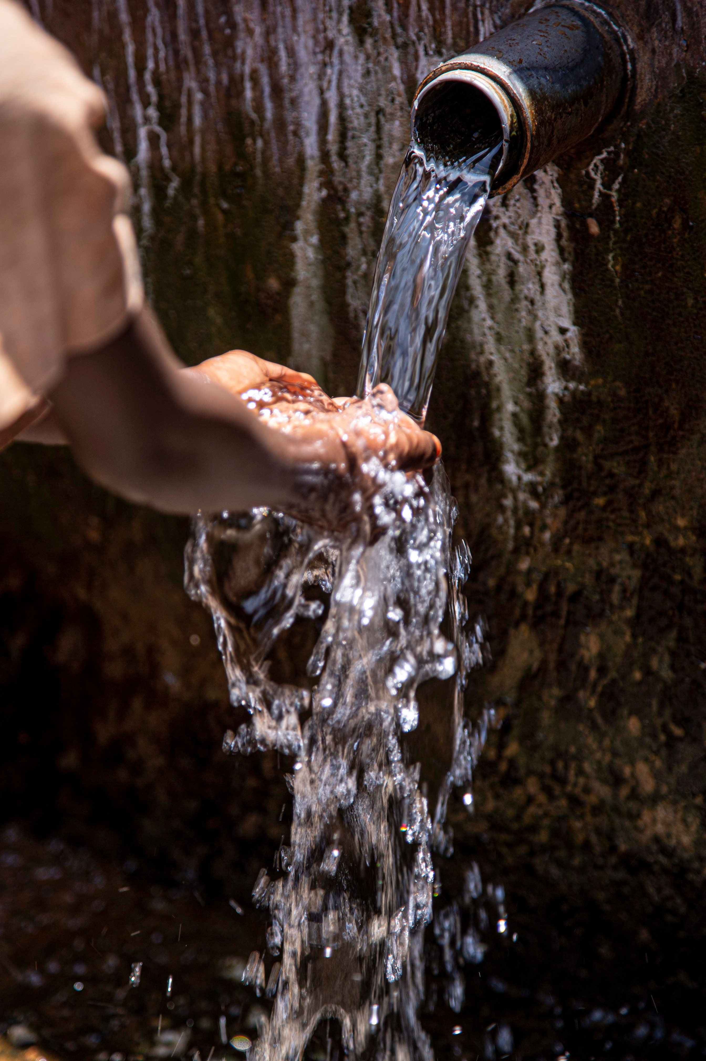
Conclusion and Recommendation
Prioritize & Diversify:
Focus on resolving open LUST cases and address emerging contaminant types.
Groundwater contamination in California, historically dominated by LUST sites and peaking in the 1990s, shows 77.8% of cases closed but 22.2% remaining open, requiring ongoing attention and proactive measures.
Integrate Data
Enhance data sharing across agencies for comprehensive contamination insights.
Proactive Prevention
Implement continuous monitoring and preventative measures to minimize future contamination.

Slide 9

THANK YOU!

